Slide 1
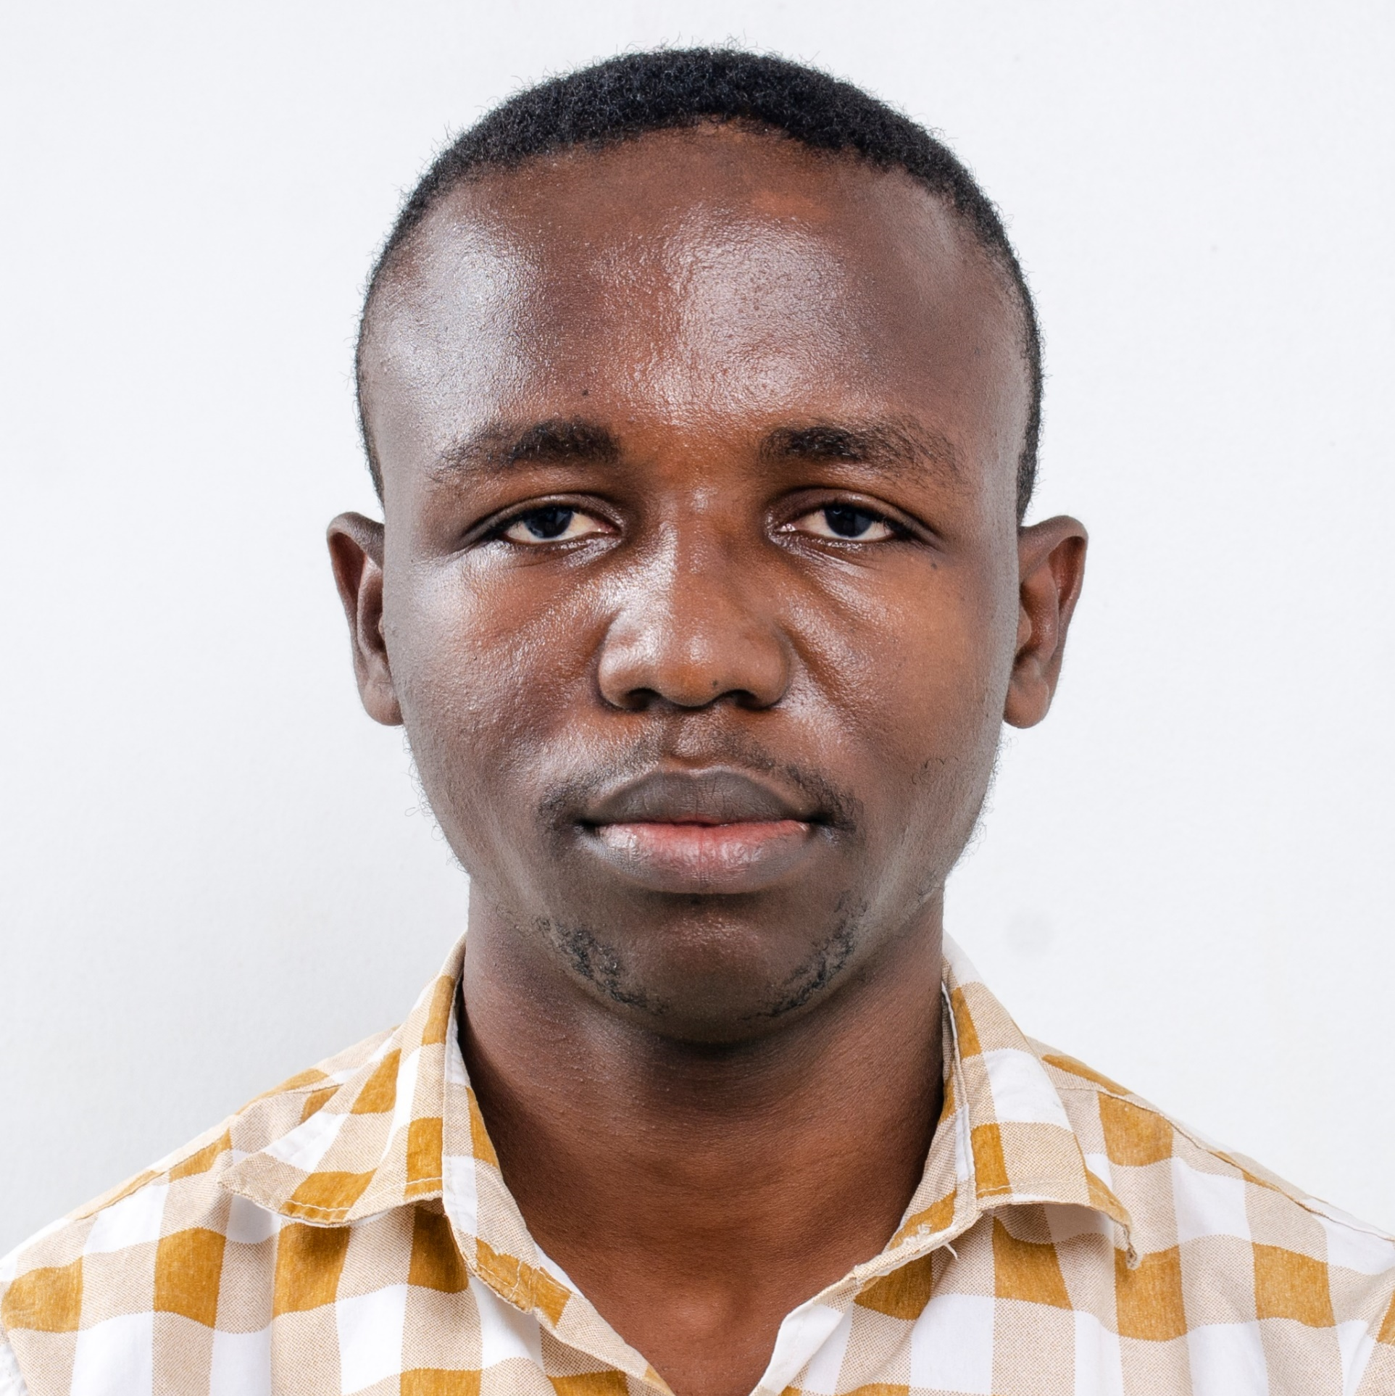
Programming: Getting Started
Robert Doe
INSTRUCTOR
@bobcumulus www.codeden.org

Slide 2
Programming
“Programming is how you get computers to solve problems.

Slide 3
Programming
“A computer program consists of code that is executed on a computer to perform particular tasks.

Slide 4
Programming
“Programming is the process of giving machines a set of instructions that describe how a program should be carried out.

Slide 5

Programmer

Slide 6
Programmer
A programmer is an individual that writes/creates computer software or applications by giving the computer specific programming instructions

Slide 7
Programming Language
“A programming language is a vocabulary and set of grammatical rules for instructing a computer or computing device to perform specific tasks.

Slide 8
Examples
Python
BASIC
C
C++
COBOL
Java
FORTRAN
Ada
Pascal

Slide 9


Inter PC Communication
0100 0010 0010
0100 0010 0010
Computers understand only machine language

Slide 10

Coding
Instruction/Code
Human attempts to write English to Computer

Slide 11
Coding
Instruction/Code
Computer does not understand English language

Slide 12
Coding
Translator
Instruction/Code
0010 0010
A translator comes in to explain what user is saying in machine language

Slide 13
Kinds of Translator
Compiler
Interpreter

Slide 14
Benefits of Programming
Coding can help you understand technology
Learning to code helps a students’ creativity
When students learn to code they develop persistence
Children improve their structural thinking when learning to code
Coding improves students’ math skills

Slide 15

Activity
Write 10 variable names under each of the datatypes that we have learnt so far.
NB: Write variable names to follow given rules in the slide

